Slide 1
Big Data in Action
Taras Bachynskyy
February, 2015

Slide 2
Introduction

Slide 3

Business Domain

Slide 4

Business Domain

Slide 5

Online Advertising

Slide 6
Online Advertising
Search
Social Media
Web Banner
Pop-ups
Email

Slide 7

General Electric

Slide 8

Red Bull

Slide 9



Online Advertising
1 billion registered users and 699 million daily active users
271 million active users
300 million active monthly users
49% of U.S. adult women visit social media sites a few times a day, whereas only 34% of men visit them

Slide 10
Key Players
Publisher - integrates advertisements into their online content
Marketer - creates and drives marketing campaign, provides the advertisements to be displayed on the publisher's content
Consumer – target audience

Slide 11

Marketer

Slide 12

Business Problem
Targeting

Slide 13




Slide 14
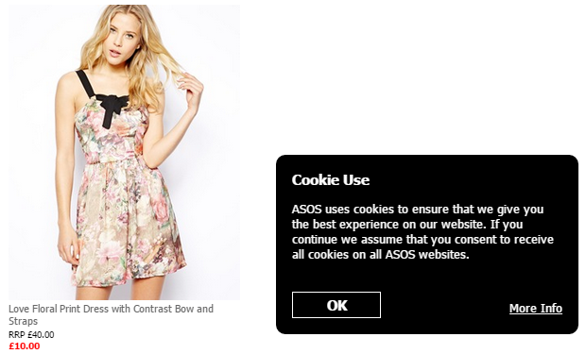
Online Advertising. Cookie Pool

Slide 15
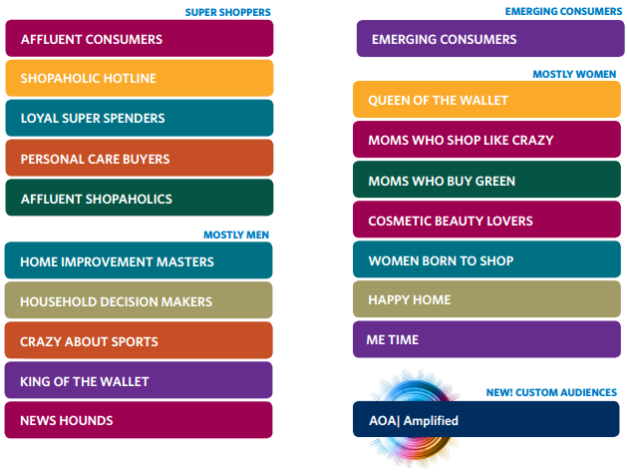
Online Advertising

Slide 16


Slide 17


Slide 18
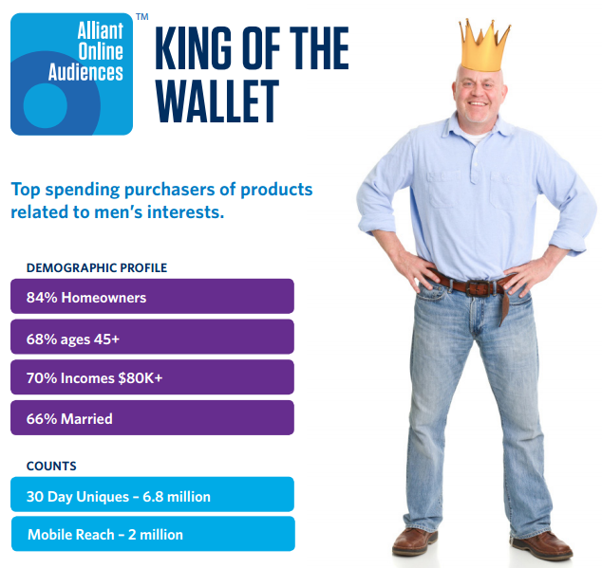

Slide 19
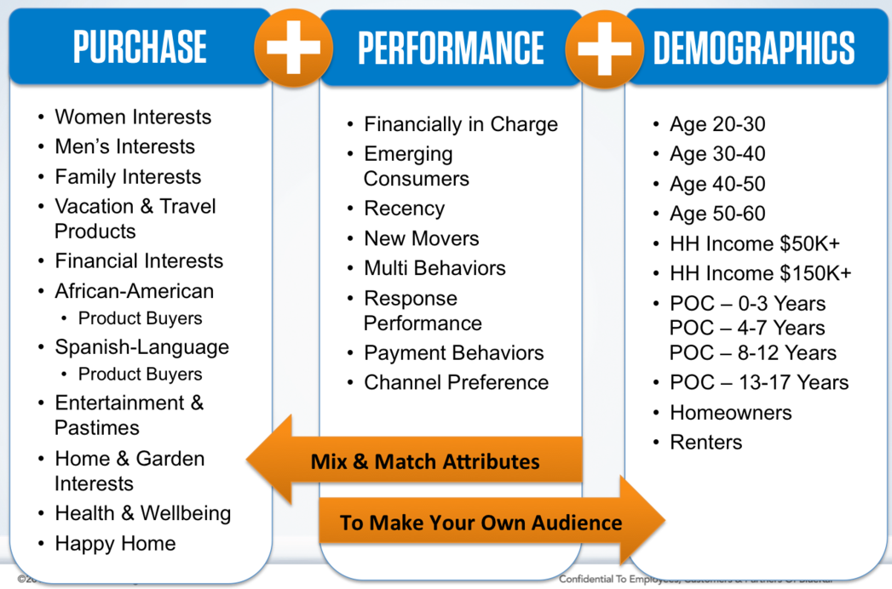

Slide 20

Online Advertising
Marketing Is Driven By Data
Challenges:
Volume: too much data
Fragmentation: too many data sources
Activation: making sure the data is not silo’d in a single location

Slide 21
Key Players
Publisher - integrates advertisements into their online content
Marketer - creates and drives marketing campaign, provides the advertisements to be displayed on the publisher's content
Consumer (cookie pool) – target audience
Agency - deeper partners than ever before: trusted partners and advisors on establishing a data-driven marketing strategy.
Data Provider – manages cookies pool and attributes

Slide 22


Demand-Side Platform (DSP)
DSPs allow advertisers to buy impressions across a range of publisher sites, but targeted to specific users based on information such as their location and their previous browsing behavior.

Slide 23
Data Management Platform
DMPs - manage cookie IDs and generate audience segments, which are subsequently used to target specific users with online ads.

Slide 24
Data Management Platform
You need a DMP if:
You manage multiple online campaigns across different ad networks, exchanges, and publishers
You want to ensure you have control over your data assets, maximize segmentation, prevent leakage and monitor partners' usage
You want to better target campaigns to improve response rates, conversion, and brand recognition
You buy media placements, third-party audience data or bid on ad exchanges on a regular basis
You want to control advertising costs and improve overall ROI

Slide 25
Data Management Platform
Generally, 50% of unique users clear their cookie every two months. This is why it is important to keep your data on users refreshed!

Slide 26

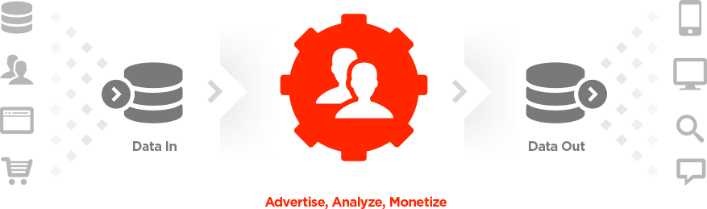
Cross-channel ID: identify your audience across any device
World’s largest aggregation of authorized 3rd party data providers
More than 200 data providers, more than 30 of whom are branded and transparent in the system.
100x of partners available across multiple channels and devices

Slide 27
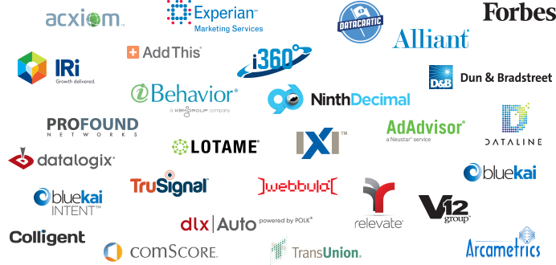
Branded Data Providers

Slide 28



Data Providers
Information on more than 235 million companies across 200 countries worldwide
credit history, B2B sales and marketing, social identity matching
Global Location Intelligence, incorporating address quality and geocoding for 240+ countries worldwide.
Credit information and information management services to approximately 45,000 businesses and approximately 500 million consumers worldwide.

Slide 29
Case Study
Website Visits
14 TB per month
350 M records per month
550 columns in fact table
Impressions
1.5 TB per month
2 B records per month
Outside Activities
200 GB per month
100 M records

Slide 30
Case Study. Technologies
Current State
Hadoop Ecosystem
Hive (HQL, functions written in Java)
Excel
To Be
Spark
Tableau or TIBCO Spotfire
Potentially Teradata

Slide 31
Case Study
Filter
Aggregate
Report

Slide 32
Case Study. Aggregation and Partitioning
Filter
Aggregate
Report
Partition by
Day
Partition by
Batch ID

Slide 33
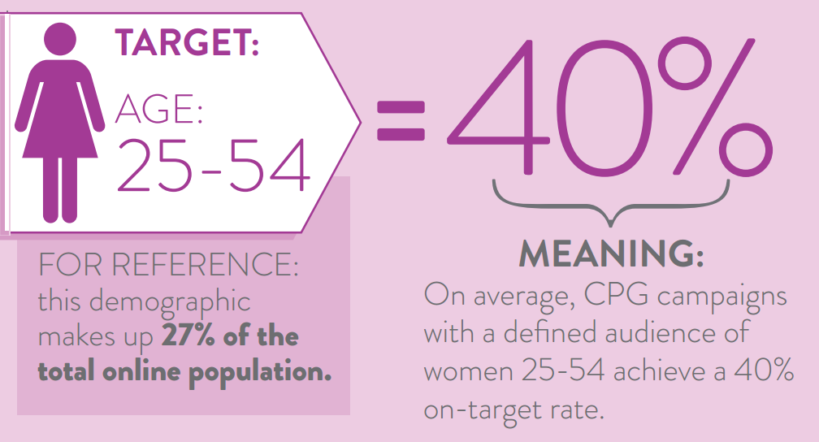
Case Study

Slide 34
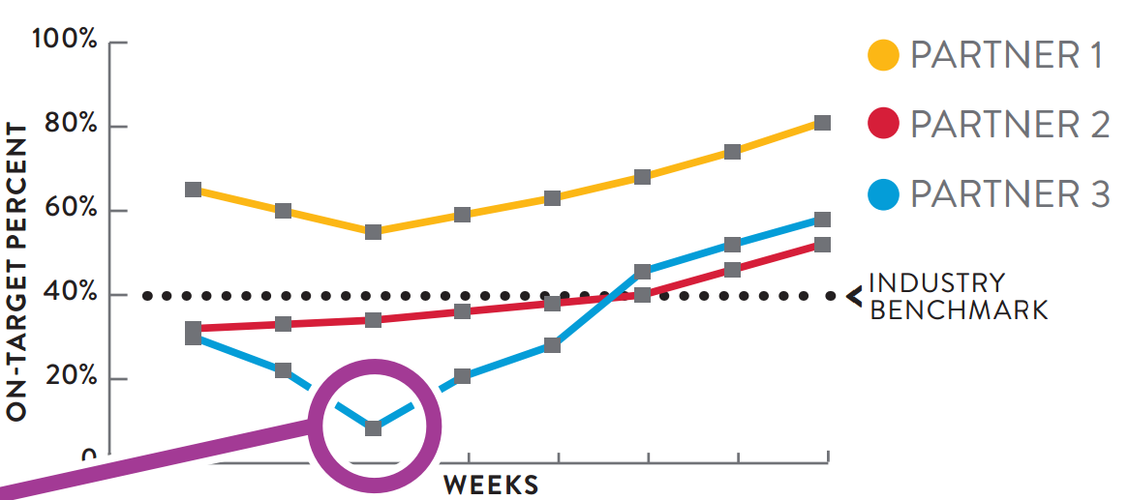
Case Study

Slide 35
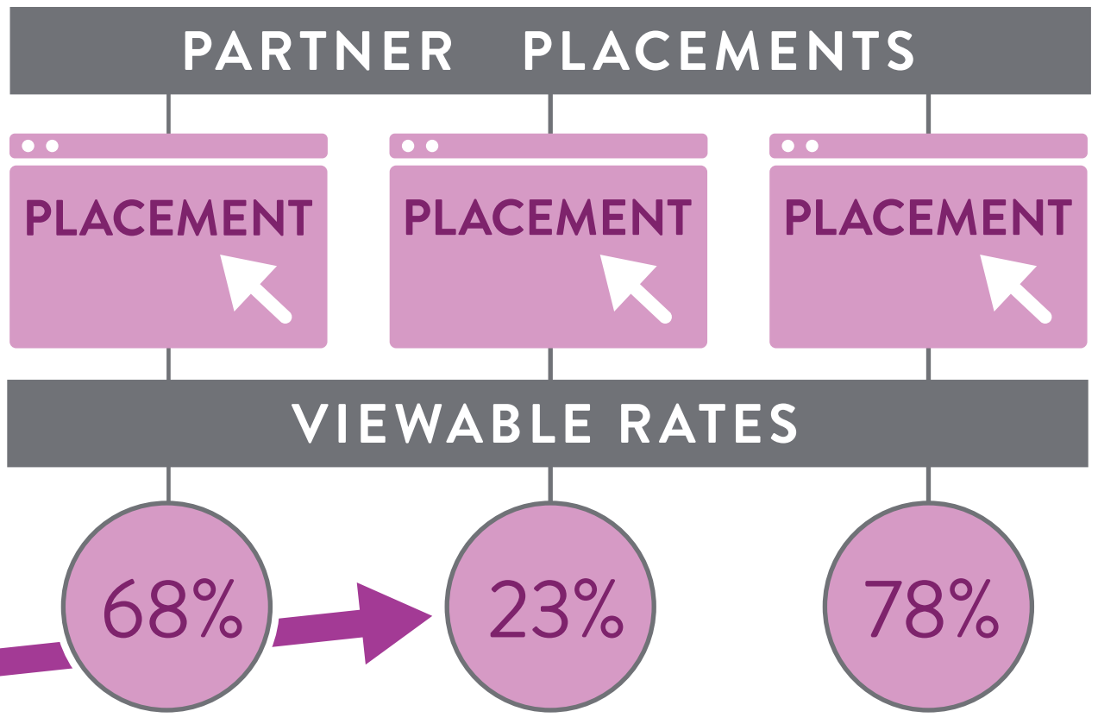
Case Study

Slide 36
Case Study
Conversion
Classification
Campaigns

Slide 37
Case Study
Key Drivers
Data Quality
Time-to-market
Extensibility
Flexibility
Low Priority
Performance
Security

Slide 38

Thank You!
SoftServe US Office
One Congress Plaza, 111 Congress Avenue, Suite 2700 Austin, TX 78701 Tel: 512.516.8880

